Slide 1


STARK HEALTH CLINIC - DIABETES PREDICTION
Ikeoluwa Akanmu

Slide 2


SITUATION
Stark Health Clinic, a prominent healthcare provider, faced challenges in early diabetes detection. The current methods lacked precision, leading to missed opportunities for timely interventions, negatively impacting patient outcomes and increasing healthcare costs.

Slide 3
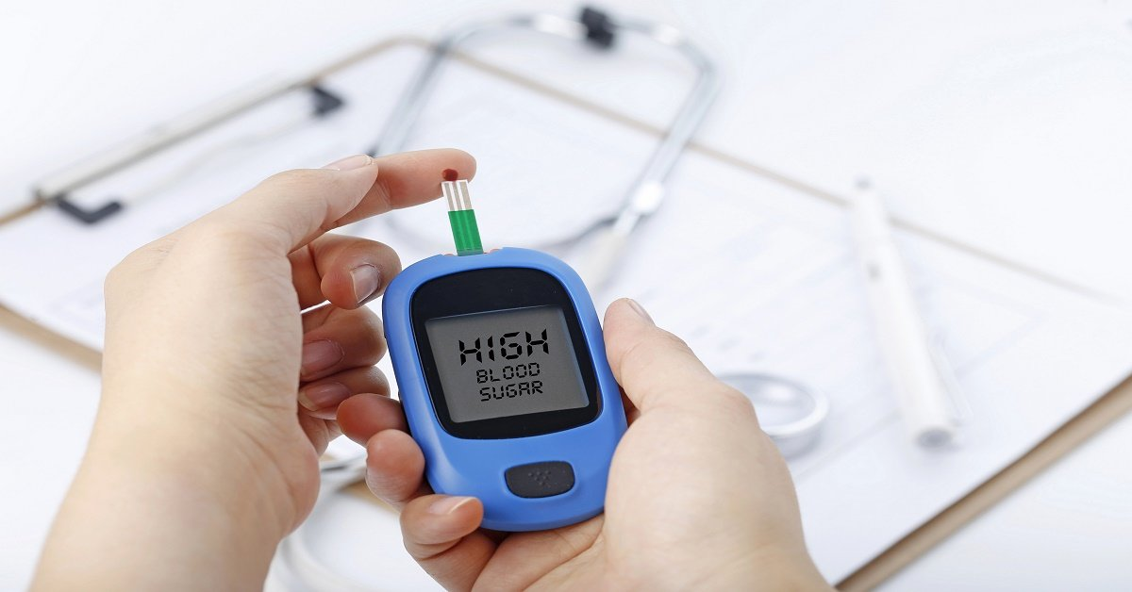
TASK
The objective of this project is to develop a robust machine learning model capable of accurately predicting the likelihood of diabetes onset.
This model will empower the clinic to take proactive measures, enhance patient care, and optimize resource allocation. Additionally, it will reveal the correlation between diabetes and some other health factors.

Slide 4

Methodology & Approach
Data Understanding
This dataset contains 100,000 records of Stack health clinic patients with 8 features that provide critical insights into patients' health profiles. Some of the features include gender, age, BMI, blood glucose level, hypertension. The dataset combines demographic, clinical, and behavioral attributes, providing a comprehensive foundation for building a predictive model to identify diabetes onset.
Data Cleaning & Preparation
Extracted the dataset and loaded into jupyter notebook.
Transformed the data by removing 3854 duplicates and identifying outliers.

Slide 5
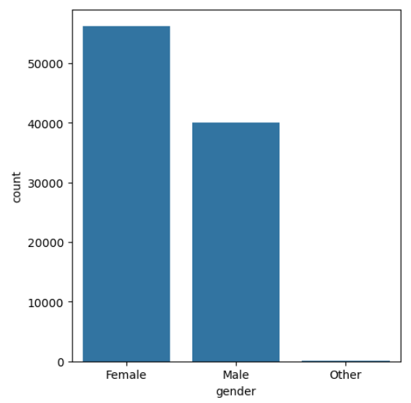
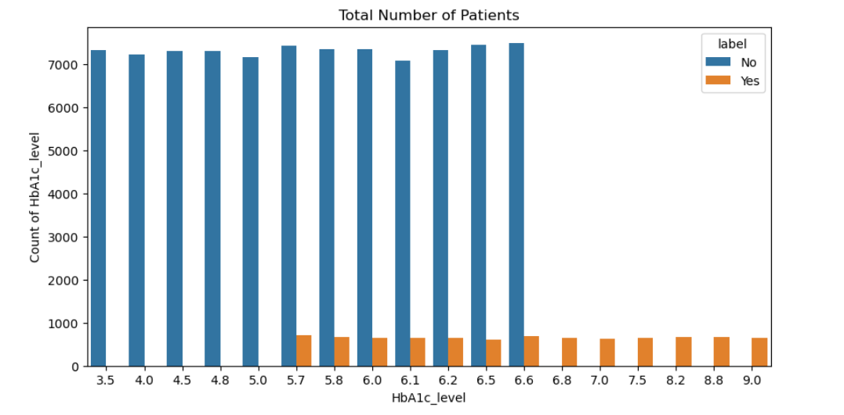
Methodology & Approach
Exploratory Data Analysis
The bar chart above shows that the higher a patient's HbA1c_level the higher the chances of being diabetic and vice versa. It also shows that diabetes begins to occur at HbA1c level of 5.7
The bar chart above shows the variation of patient gender in the data set.

Slide 6
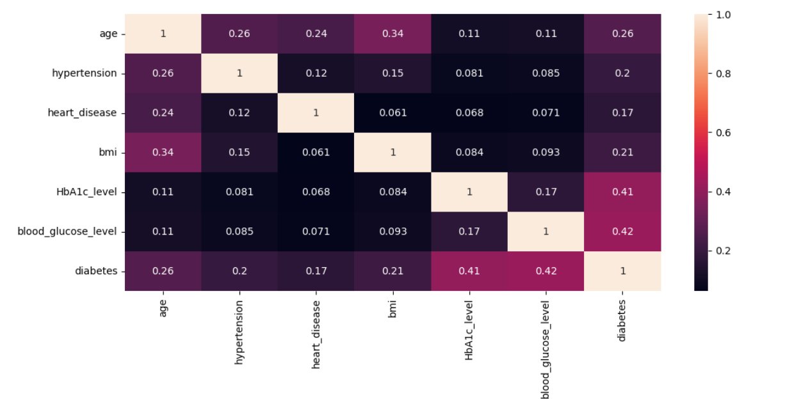
Methodology & Approach
Correlation Heatmap

Slide 7
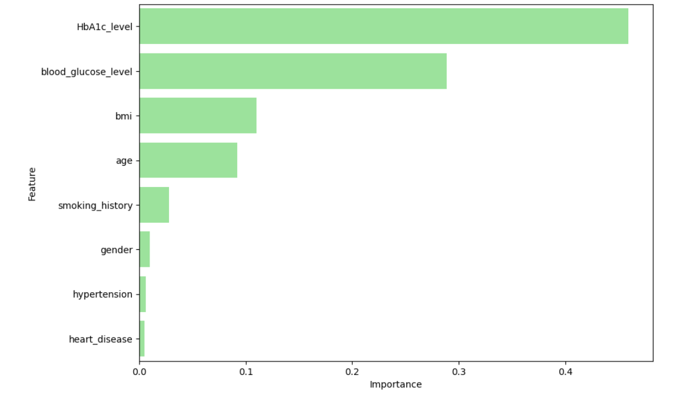
Methodology & Approach
Feature Importance

Slide 8
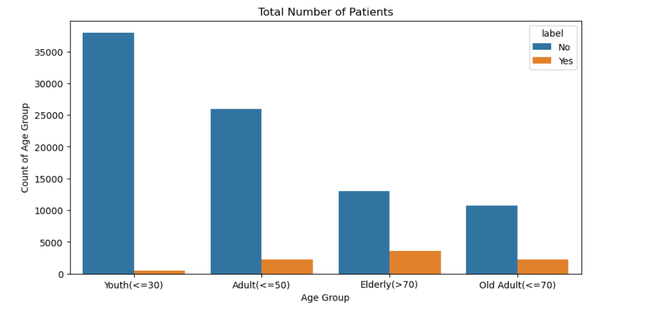
Methodology & Approach
Feature Engineering
Identified and labeled ‘diabetes’ as the target variable.
Grouped the age variable into 4 age brackets.
Fit and transformed categorical data (gender & smoking history) to numerical data using LabelEncoder.
Model Selection and Training
Split the data into train and test set (80:20 respectively).
Initialized and trained the model using 4 classifiers; Logistic Regression, SGD classifier, Decision Tree and Random Forest.
Scaled the data using MinMaxScaler
The chart above shows that patients older than 70 years are more likely to be diabetic than the youth and other age groups.

Slide 9
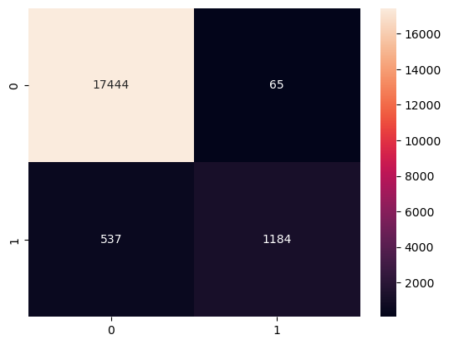
Model Evaluation
Random Forest Classification Report
 | Precision | Recall | F1-score
0 | 0.97 | 1.00 | 0.98
1 | 0.95 | 0.69 | 0.80
Accuracy |  |  | 0.97
Macro avg | 0.96 | 0.84 | 0.89
Weighted avg | 0.97 | 0.97 | 0.97

Slide 10

Model Evaluation
Decision Tree Classification Report
 | Precision | Recall | F1-score
0 | 0.97 | 0.97 | 0.97
1 | 0.71 | 0.74 | 0.72
Accuracy |  |  | 0.95
Macro avg | 0.84 | 0.85 | 0.85
Weighted avg | 0.95 | 0.95 | 0.95

Slide 11

Model Evaluation
SGD Classification Report
 | Precision | Recall | F1-score
0 | 0.97 | 0.96 | 0.97
1 | 0.65 | 0.75 | 0.70
Accuracy |  |  | 0.94
Macro avg | 0.81 | 0.85 | 0.83
Weighted avg | 0.95 | 0.94 | 0.94

Slide 12

Model Evaluation
Logistic Regression Classification Report
 | Precision | Recall | F1-score
0 | 0.98 | 0.95 | 0.96
1 | 0.60 | 0.77 | 0.68
Accuracy |  |  | 0.93
Macro avg | 0.79 | 0.86 | 0.82
Weighted avg | 0.94 | 0.93 | 0.94

Slide 13
Model Analysis
Logistic Regression
Strengths: High overall accuracy (93%) and weighted averages for precision, recall, and F1-score.
Weaknesses: The recall for the positive class (1) is 0.77, indicating a moderate ability to correctly identify patients with diabetes.
SGD Classifier
Strengths: Slightly higher recall for the positive class (0.75) compared to Logistic Regression, contributing to better identification of diabetes cases.
Weaknesses: F1-score and precision for the positive class remain relatively moderate (0.70 and 0.65, respectively).
Decision Tree
Strengths: Balanced performance across all metrics with an overall accuracy of 95%. Recall for the positive class is 0.74, indicating decent identification of diabetic patients.
Weaknesses: Slightly lower precision and F1-score for the positive class compared to Random Forest.
Random Forest
Strengths: The highest overall accuracy (97%) and precision for the positive class (0.95). This model excels in reducing false positives.
Weaknesses: Lower recall for the positive class (0.69) compared to the Decision Tree and Logistic Regression, indicating some under-detection of diabetes cases.

Slide 14

Result and Recommendation
Key Metrics
Recall for Class 1 (Positive Class): Critical for identifying true cases of diabetes to ensure timely interventions.
Precision for Class 1 (Positive Class): Helps reduce unnecessary resource allocation due to false positives but is secondary to recall.
F1-Score for Class 1: Balances recall and precision, providing a holistic view of the model's ability to manage positive cases.
Business Priority
The business should prioritize minimizing false negatives, as failing to identify diabetic patients can lead to severe health complications and increased long-term healthcare costs. A model with higher recall for the positive class, even at the expense of precision, would be more beneficial. Models like Logistic Regression and Decision Tree are better aligned with this goal compared to Random Forest.

Slide 15
T
H
A
N
K
Y
O
U

